Slide 1

Gesture Control
MediaPlayer!
Using Mediapipe
Notes:
To use this title animation slide with a new image simply 1) move the top semi-transparent shape to the side, 2) delete placeholder image, 3) click on the picture icon to add a new picture, 4) Move semi-transparent shape back to original position, 5) Update text on slide.

Slide 2


Content
Objective
Introduction
Requirements
Used Libraries
Snapshots
Reference

Slide 3
OBJECTIVE
“Develop a Media Player Controller Using MediaPipe for Gesture-Based Media Playback-
MediaGest.”

Slide 4
INTRODUCTION
Our mission
The "Media Player Controller using MediaPipe" represents a significant breakthrough in modern media control.
In the ever-evolving digital media landscape, innovative technologies are reshaping hands-free interaction with our favorite content.
This project is more than just a controller. it's a bridge between technology and human expression. It's a testament to the power of innovation, bringing you closer to your media, your way. Join us as we unravel the capabilities of the Media Player Controller using MediaPipe and embark on a new era of interactive media playback.

Slide 5
REQUIREMENTS
Hardware Requirements :-
CPU: Intel Core i5 or equivalent.
RAM: Minimum 4 GB.
Storage: Not large.
Operating System: Compatible with all.
Software Requirements :-
Python
Operating System
Python Package Manager

Slide 6
USED LIBRARIES
The development of a Media Player Controller using MediaPipe involves the integration of various libraries and frameworks to achieve seamless and responsive media control.
“OpenCV”
it is a huge open-source library used for computer vision applications, in areas powered by Artificial Intelligence or Machine Learning algorithms, and for completing tasks that need image processing.
“mediapipe”
MediaPipe is an open-source framework for building pipelines to perform computer vision inference over arbitrary sensory data such as video or audio.
“pyautogui”
Python control the mouse and keyboard, and other GUI automation tasks. For Windows, macOS and Linux on Python 3 and 2.

Slide 7
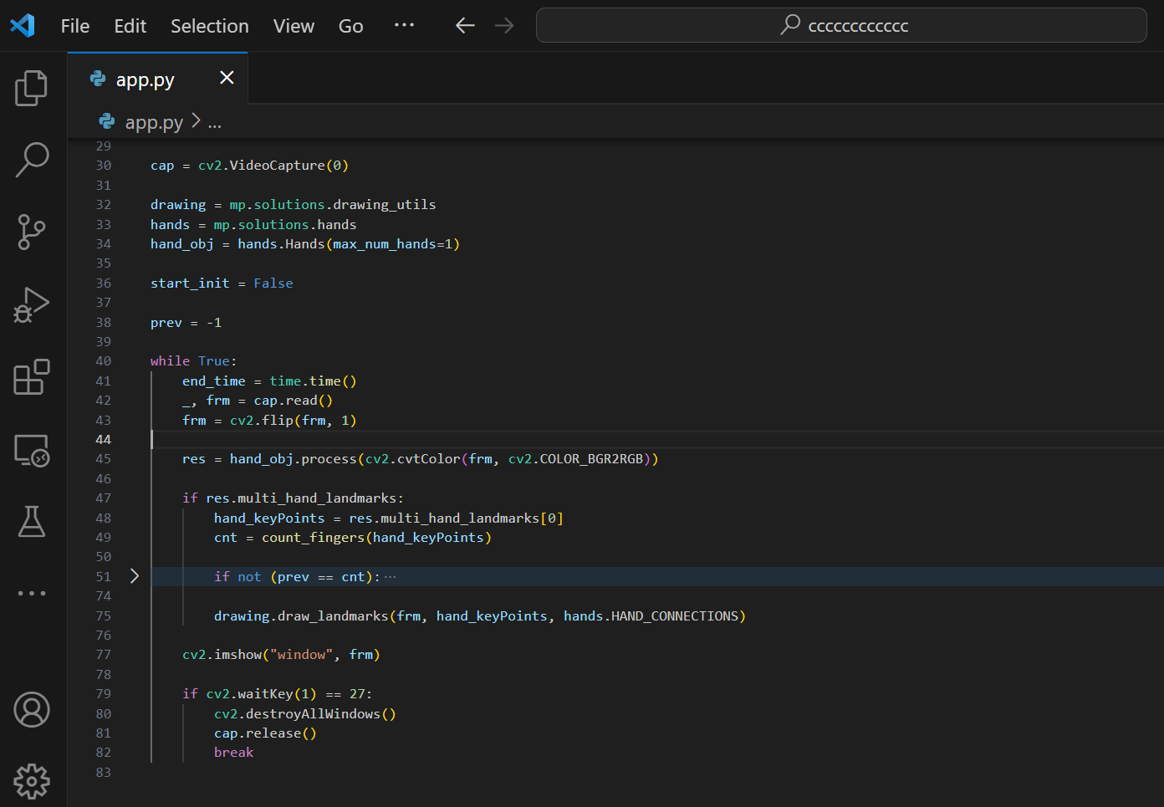
SNAPSHOTS
!

Slide 8
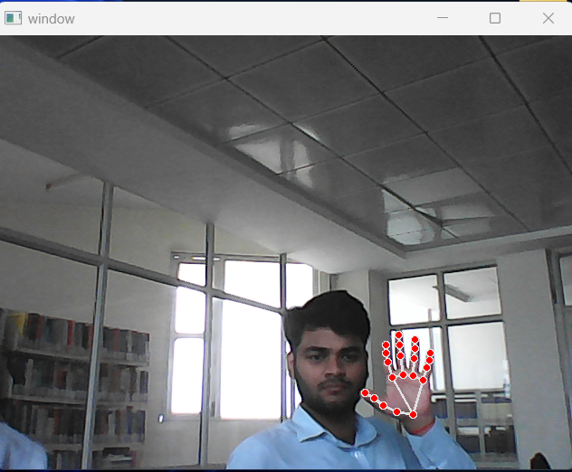
SNAPSHOTS
!

Slide 9
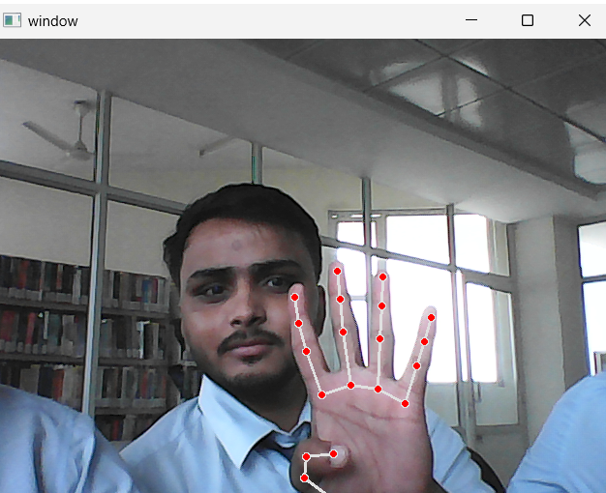
SNAPSHOTS
!

Slide 10
https://www.youtube.com/watch?v=NGEyIfX4GGk
REFERENCE

Slide 11
Thank You

